Slide 1
Descriptive Statistics
Content
Completion by level of Program
Effects of Tuition fees on Endowment assets
References

Slide 2
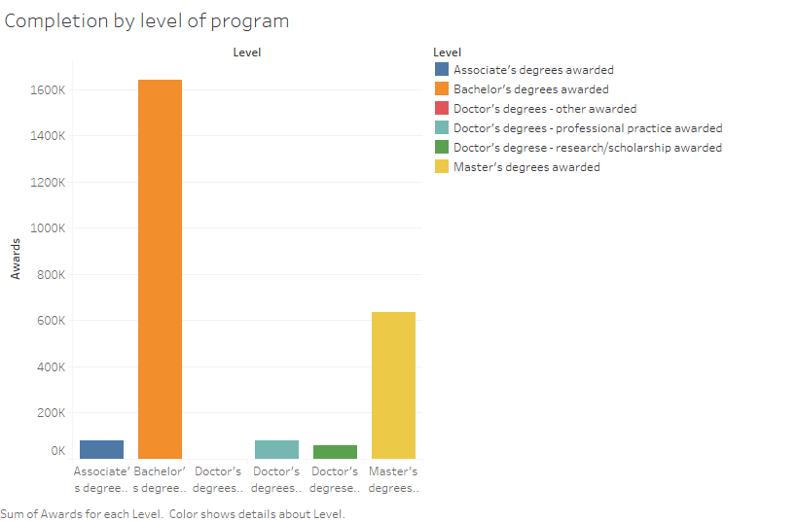
Completion by level of Program
Bachelor’s degree level has the highest completion number.
Master’s degrees comes is second best.
Highest completion by level is at 1600k awards.
Lowest completion by level is at 60k awards.

Slide 3
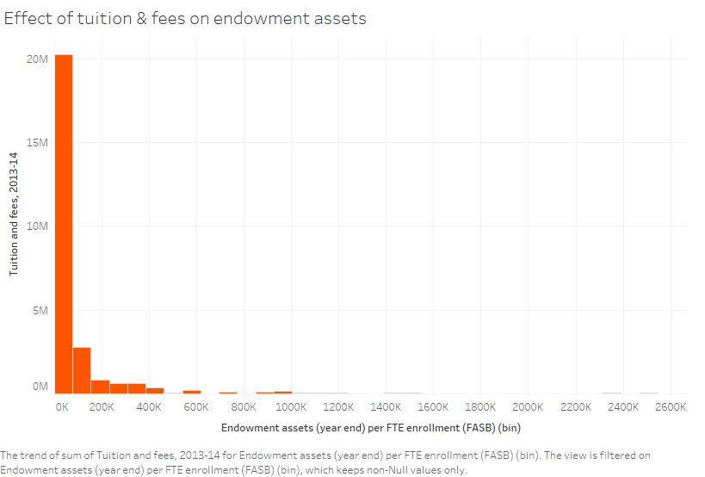
Effects of Tuition fees on Endowment assets
Endowment assets are inversely proportional to Tuition fees.
With a low endowment assets (year end), there’s a high sum of tuition fees (2013-2014).
An increase in the sum of tuition fees means a decrease in the endowment assets (year end).
The highest sum recorded in this period (2013-2014) is 20M.
With endowment assets of 1000k, the sum of tuition fee is almost zero.

Slide 4
References
  Procheş, Ş. (2015). Descriptive statistics in research and teaching: are we losing the middle ground?. Quality & Quantity. 50. 10.1007/s11135-015-0256-3.

